Slide 1
Turbine Blades and Single Crystal
Qing Wang, Matthias ihme
2018/05/17

Slide 2
Turbine blades introduction Issues and solutions
Creep
Tendency of blade materials to deform at a temperature dependent rate under stresses well below the materials’ yield strength
Solution
Cooling
Improved material

Slide 3
Cooling of turbine blades
Internal cooling
Convective cooling
passing cooling air through passages internal to the blade
heat is transferred by convection into the air flowing inside of the blade
Impingement cooling
hitting the inner surface of the blade with high velocity air
used in the regions of greatest heat loads
External cooling
Film & transpiration cooling
creates a thin film of cooling air on the blade by injecting/leaking air through small holes in the structure
Effusion cooling
cooling air forced through porous holes which forms a film or cooler boundary layer on blade surface
Pin fin cooling

Slide 4
Material of turbine blades
Superalloys
Advantages
excellent mechanical strength
resistance to thermal creep deformation
good surface stability
resistance to corrosion or oxidation
Chemical composition
Base: Nickel (Ni)
Additional elements: Cobalt (Co), Tantalum (Ta), Aluminum (Al), Tungsten (W), rhenium (Re), others
Fabrication
Vacuum induction melting (1950s)
Hot isostatic pressing
Thermal barrier coatings (TBC)
Material: aluminide (1970s), ceramic (1980s)
Improves corrosion and oxidation resistance
Directional solidification and single crystal

Slide 5
Single crystal turbine blades
A single crystal is a material in which the crystal lattice of the entire sample is continuous and unbroken to the edges of the sample (no grain boundaries)
Properties
Anisotropic (depending on crystallographic structure)
Improved ductility and thermal fatigue life (failure of material, e.g. crack/fatigue initiation, corrosion, starts from imperfections or impurities in crystalline structure)
More tolerance to localized strains
Turbine blades progressed (left to right) from equiaxed, to directional solidified (DS), to single crystal (SX). (Photo courtesy of Howmet Corp.)

Slide 6
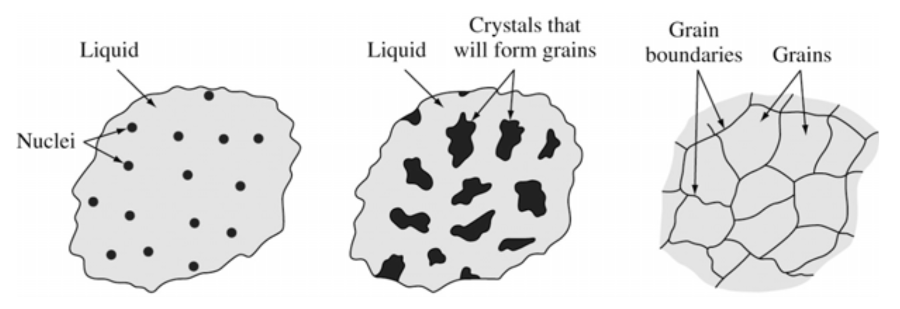
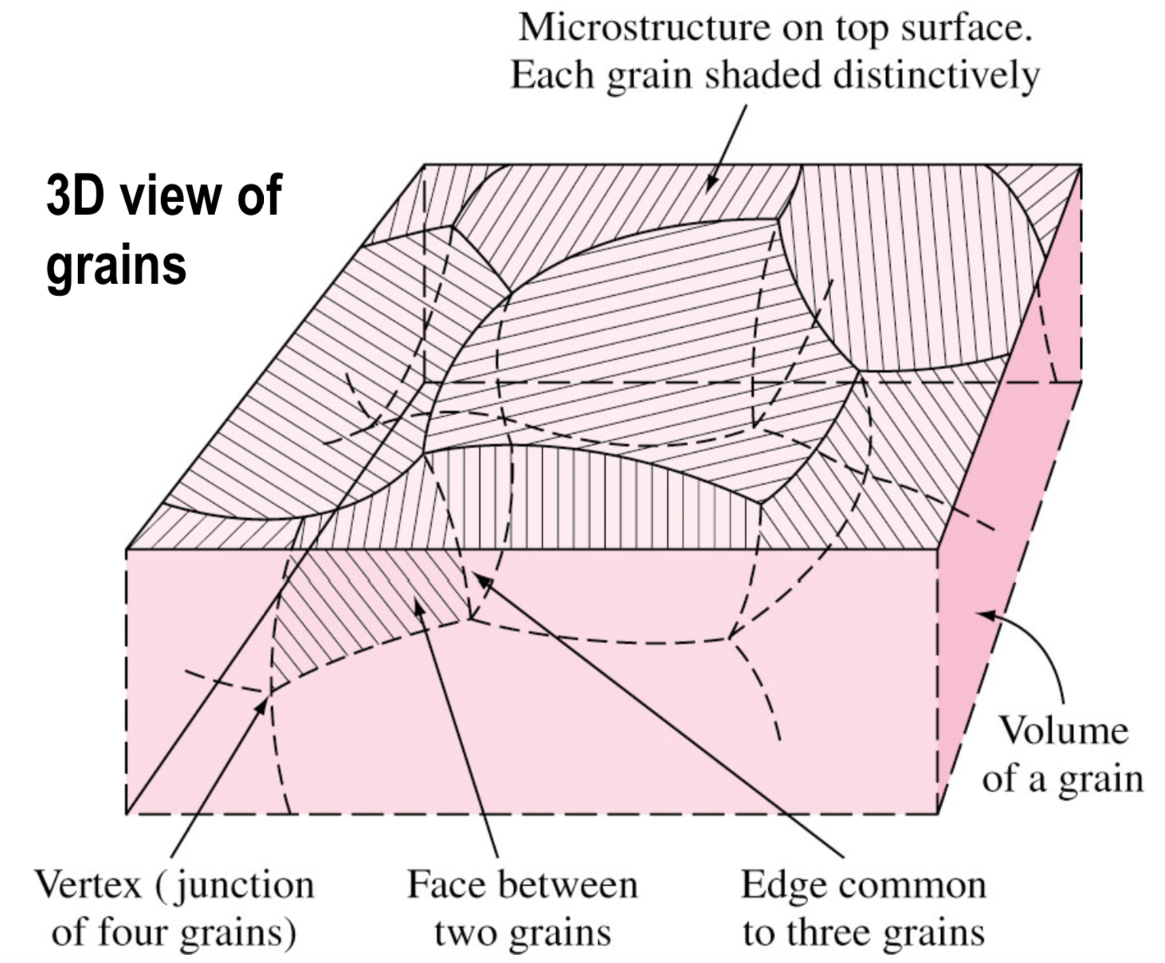
Nucleation and crystallization
Metals are melted then solidified to produce finished and semi-finished parts
Grains: crystals in solidified metals
Two steps of solidification
Nucleation : Formation of stable nuclei
Growth of nuclei : Formation of grain structure
Crystal boundaries are formed when crystals join together at complete solidification, which separates grains
Thermal gradients define the shape of each grain
More the number of nucleation sites available, more the number of grains formed, and finer the grains

Slide 7
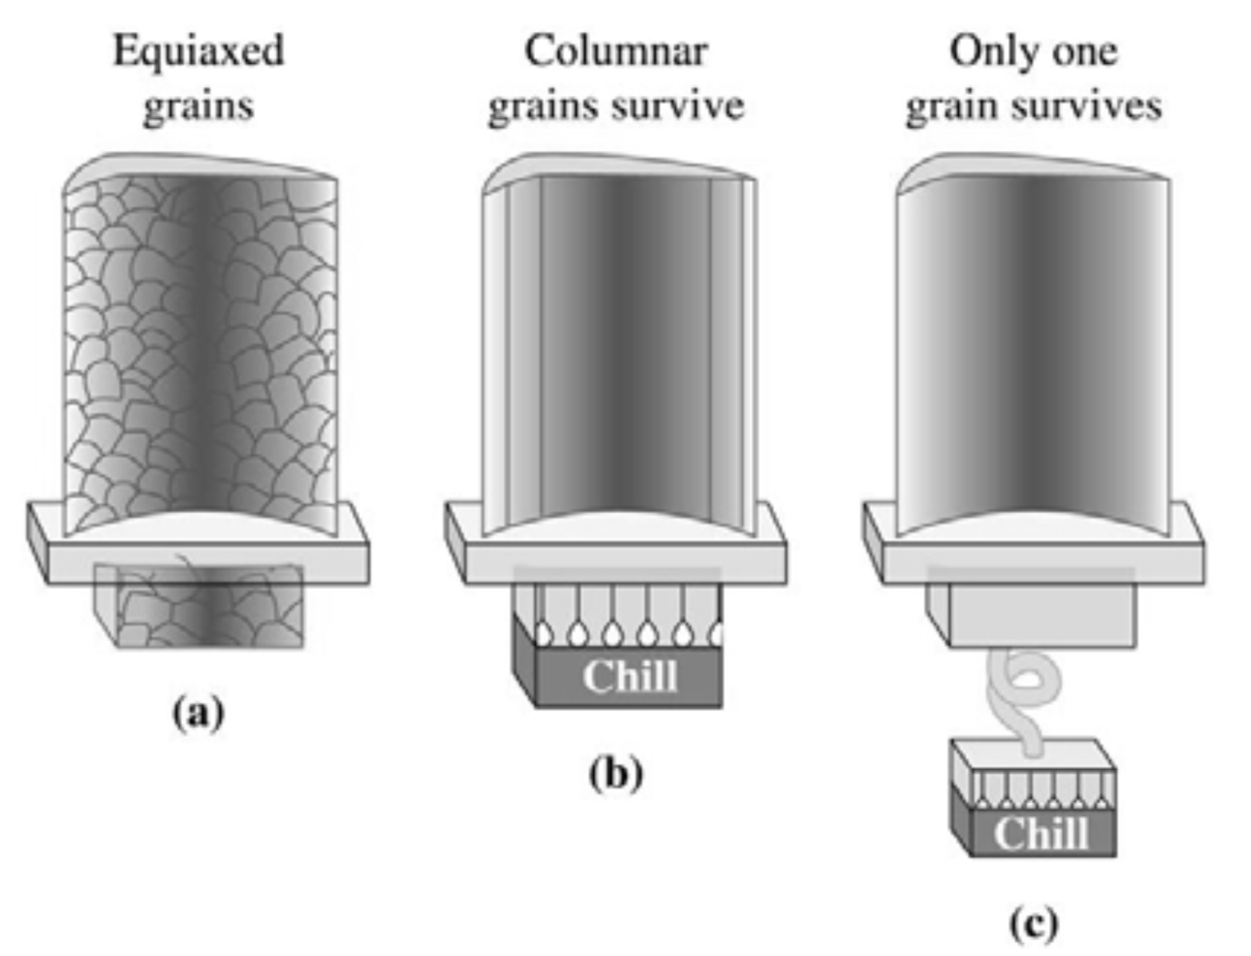
Types of grains
Equiaxed grains
Crystals grow equally in all directions
Formed at the sites of high concentration of nuclei
Commonly formed adjacent to cold mold wall
Alloy contains carbon, boron, zirconium
Segregate preferentially to grain boundaries
Provide high-temperature high-boundary strength and ductility for creep resistance
Columnar grains
Long, thin, and coarse
Grow predominantly in one direction
Formed at the sites of slow cooling and steep temperature gradient
Better creep and fracture resistance
Grains structures in turbine blades:
Conventional equiaxed grains
Directionally solidified columnar grains
Single crystal (SX)

Slide 8

Manufacturing of a single crystal blade Air-cooled blades

Slide 9
Manufacturing of a single crystal blade Single crystal blade
Directional solidification
Pouring molten superalloy metal into a vertically mounted mold heated to metal melt temperature
Latent heat of solidification is removed by a water-cooled copper chill plate at the bottom of the mold
The ceramic mold is surrounded by a temperature-controlled enclosure to to keep the sides of the mold at a constant temperature which prevent localized crystallization
Single crystal
Number of crystals reduces if a right-angle bend is put a short distance above the chill plate in the casting mold
“Pigtail”: single crystal selector
A helical channel with smooth continuous turnings
Admitting columnar crystals from the starter
Letting just one crystal rise above the helix and start to form the entire blade

Slide 10
Summary
Turbine blades are exposed to high temperature gas flows and suffered from high stresses, which may lead to creep failure
To prevent creep, increase the life, and improve efficiency, various cooling techniques and advanced materials are applied in turbine blade designs
Single crystal technique removes the grain boundaries which effectively improves the life in terms of creep strength and thermal fatigue resistence

